Slide 1

SERVER MONITORING
Submitted in partial fulfillment of award of degree of
Bachelor of Technology
In Information Technology
Submitted By:
Amanpreet Singh (07 / IT2 / 2008)
Chitra Choudhary (67 / IT2 / 2008)
Navdeep Singh (26 / IT2 / 2008)
Pulkit Bindra (23 / IT2 / 2008)
Under the guidance of
Ms. Shalini
Department Of Information Technology
Guru Tegh Bahadur Institute of Technology
Guru Gobind Singh Indraprastha University
Sec 16C, Dwarka, New Delhi
Year 2011-2012

Slide 2

Contents
Introduction
System Configuration
Modules in the Project
Network Monitoring
Network Traffic Management
System Snapshot
Alerting Engine
Screen Shots
Future Enhancement
Bibliography

Slide 3

Introduction
Tests and verifies different services of a server
Ensure all services are being delivered to end user adequately.
It is developed in order to help the businesses to ensure that their network is
live and responding.
Server monitoring may be
i. Internal, i.e. web server software checks its status and notifies the owner if
some services go down
ii. External, i.e. some web server monitoring companies check the services
status with a certain frequency.

Slide 4
System Configuration
HARDWARE REQUIREMENTS
PROCESSOR | RAM | DISK SPACE
Pentium-IV or advanced | 512 Mb or higher | 100 Mb or higher if available
SOFTWARE REQUIREMENTS
OPERATING SYSTEM | DATABASE | PLATFORM
Windows XP or any other higher version with Internet connection. | SQL | Microsoft Visual Studio 2008 supporting C# applications.

Slide 5
Modules in the Project
Server Monitoring
Extensive Network Monitoring
Flexible Alerting Engine
Memory and Performance Management
System Snapshot

Slide 6
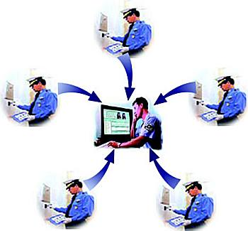
Network Monitoring
Use of a system that constantly monitors a computer network
for slow or failing components
Notification to network administrator (via email)
in case of outages.
It is a subset of the functions involved in network management.
High network monitoring includes:
Route Tracing - It traces the route from a user to the host and gives the IP address
of each node in the way.
DNS - Get the correct IP address back from the DNS server
Web Services - Verify the status and content of your web servers (HTTP, HTTPS).

Slide 7

Memory and Performance Management
Memory and Performance Management is the process of determining the network resources required to prevent a performance or availability impact on business-critical applications.
Performance management is the practice of managing network service response time, consistency, and quality for individual and overall services

Slide 8
System Snapshot
Displays the necessary details of the softwares installed on the server and clients associated with it.
System snapshot is composed of two modules:
1) Fetching client system details on server
2) Fetching current system details

Slide 9


Alerting Engine
Flexible Alerting engine will be designed for real life
alerting with maximum alerting types.
Notifications are sent via:
SMTP mail - With or without authentication

Slide 10
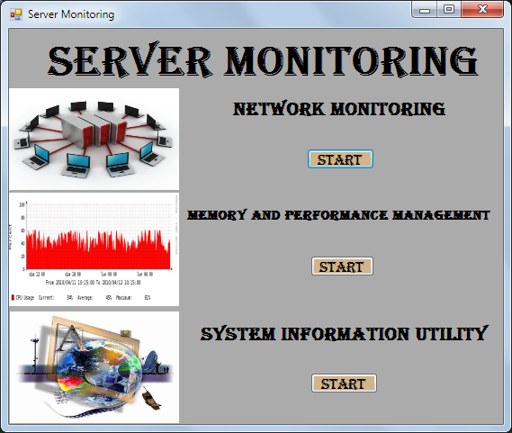
Screen Shots
SERVER MONITORING
Home page

Slide 11
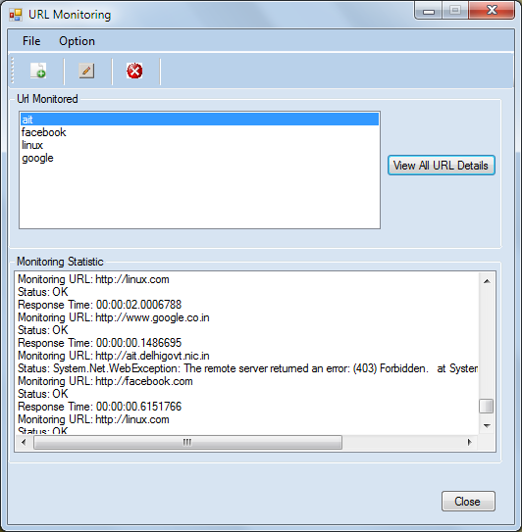
Network Monitoring Screen

Slide 12
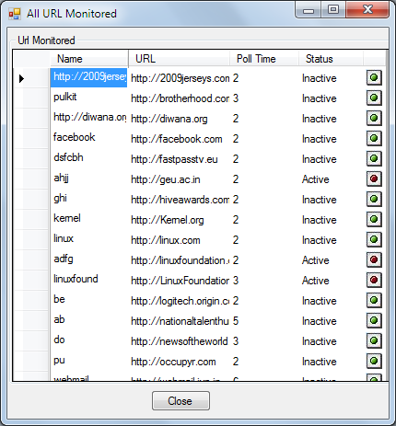
All URL Monitored Screen

Slide 13
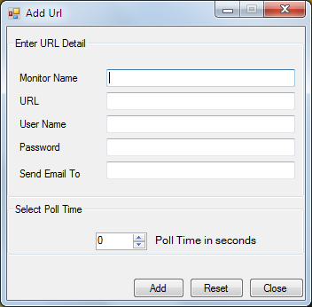
Add URL Form

Slide 14
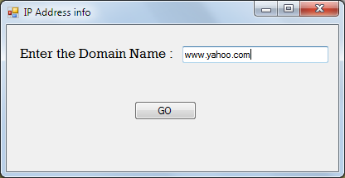
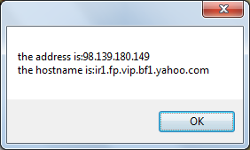
IP Address Finder Screen

Slide 15
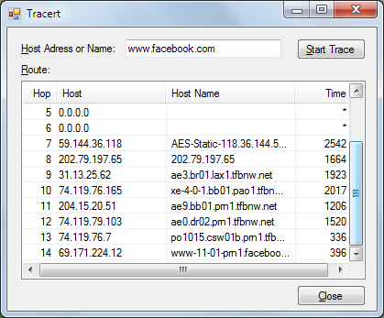
Route Tracing

Slide 16
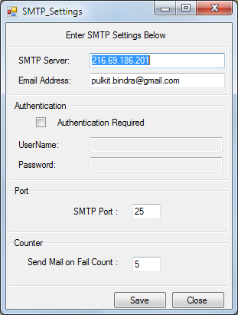
SMTP Settings

Slide 17
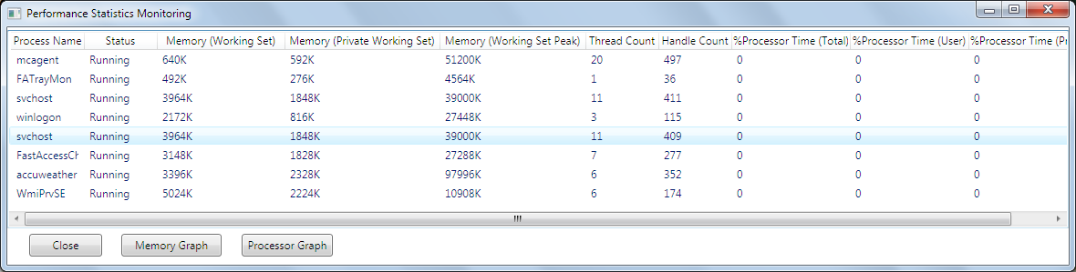
MEMORY AND PERFORMANCE MANAGEMENT

Slide 18
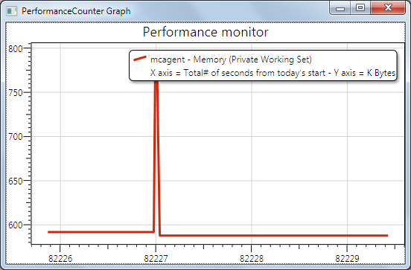
Performance graph for memory management

Slide 19
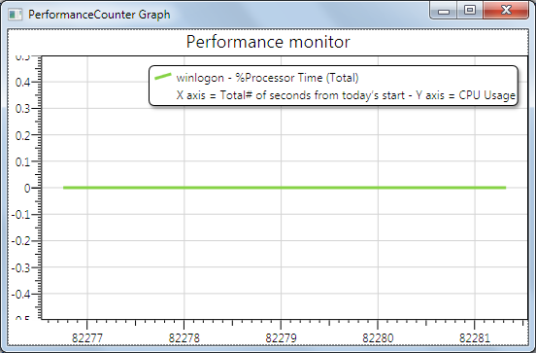
Performance graph for memory management

Slide 20
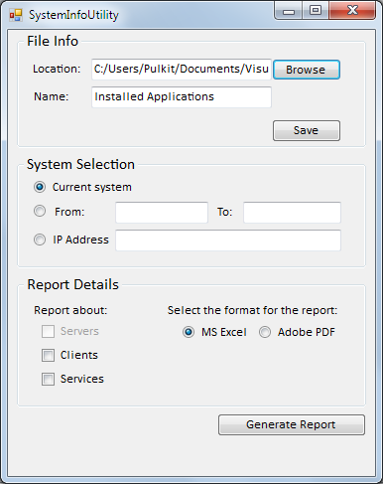
SYSTEM INFORMATION UTILITY
User Interface

Slide 21
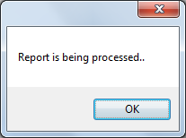
Processing of Report

Slide 22
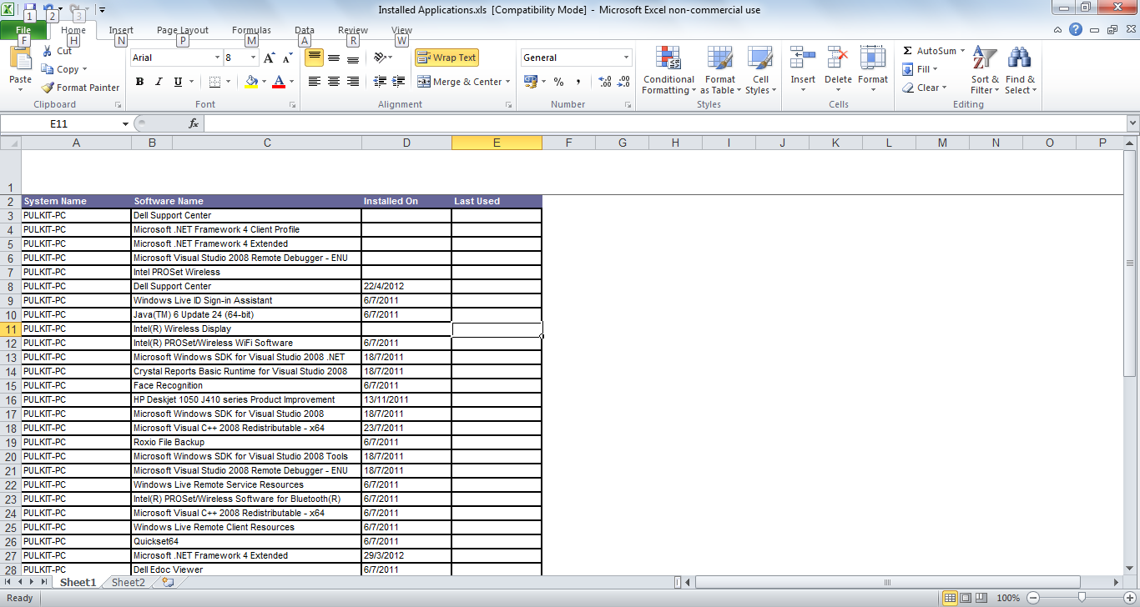
Reports
Report Generated for Softwares installed on the system

Slide 23
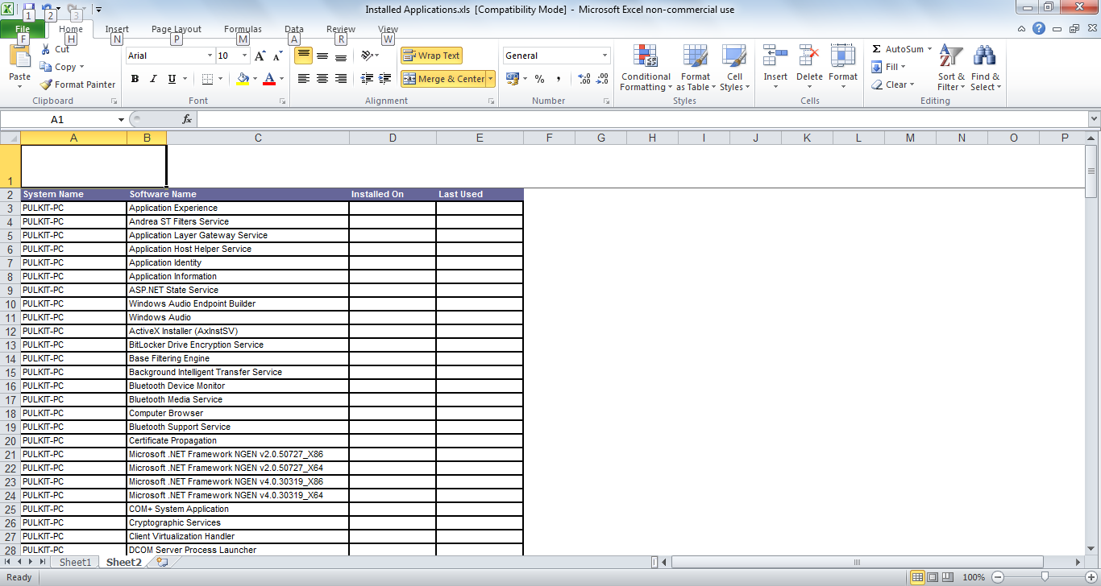
Report Generated for Softwares installed on the system

Slide 24
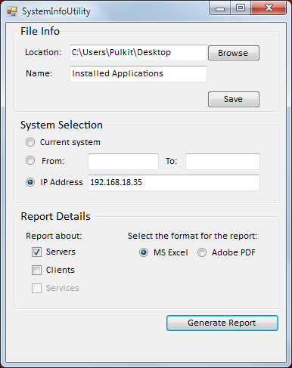
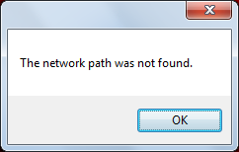
Message Box displaying unauthorized access

Slide 25

Future Enhancement
More components can be monitored.
SMS in addition to Mails can be sent to the authorities for quick action and repair of the link.
The User Interface can be made more user friendly and attractive
Graphs and line charts can be added for quick view of the monitoring report of a specific link
Location of a given IP address can be traced using Google Maps and location facilities and enhancing the database

Slide 26
References
BOOKS
1. C#
SAMS Teach yourself c# in 21 days, ISBN: 0672327112
C# in depth By Jon Skeet (Ch 1-5), ISBN: 1935182471
2. ASP.NET
Black Book(Ch 4-8), ISBN : 9789350040430
ONLINE REFERENCE
http://www.xdevsoftware.com/blog/post/Website-Monitoring-Simple-Website-Monitor.aspx
http://www.eggheadcafe.com/articles/20040516.asp
http://www.howtogeek.com/howto/programming/get-ip-address-from-dns-hostname-in-c/
http://stackoverflow.com/questions/570098/in-c-how-to-check-if-a-tcp-port-is-available

Slide 27

Thank You

